Slide 1
Cognition Fundamentals: Kick-off
What is Cognition and how did it develop as a field?
Responsible Lecturer: Bram Heijligers

Slide 2

A lecture...
About cognition? But we’re making robots not humans...
Notes:
Well, here you are: sitting down, attending a lecture. Not really very remarkable, you might think—initially. What’s more, the lecture is about cognition, a topic you might be expecting to find dull and hardly relevant to what people usually expect artificial intelligence to be about. Is cognition really that important? If so, are they really as interesting as other aspects of artificial intelligence?
Let us consider this by asking some questions. How did you hear about this study? Why did you decide to enroll? Perhaps someone told you about it. How do you remember who told you? Would you recognise that person if you saw them again? How did you understand what they said to you? If you had to go to the ADSAI website, how did you know what to do there, or how use the project brief overview? How do you know what a the right content for which day looks like and where to find it? How did you avoid walking into people on your route? How did you read the words on the slide on the board? And how do you remember what they mean? If you don’t and want to google them, how do you manage to reach for your phone or keyboard rather then your water bottle?

Slide 3
Cognition: Attention, Perception, Memory
Cognition VS Psychology
Cognitive science is concerned with the changes occurring in the nervous system when an individual performs some high level cognitive function. It aims at studying how different parts of the brain work in tandem to produce a particular reaction to a given stimulus. The field is more research based.
Psychology on the other hand deals with people with feelings and does not look at them as research objects only. It is more interventional in nature. It helps people to work on their thinking to improve their behaviour in society.
Notes:
The answers to these questions involve attention, perception and memory. Let’s take a moment to read the text on screen.
Now, while you are reading, you are moving your eyes along the lines of text—effortlessly. You are paying attention to reading; you perceive the words and know what they mean because you have learnt them and they are stored in your memory. As you read on you may learn new things that will also become stored in memory, but how will you be able to recall what you have learned when it comes to applying it to the project brief?
The environment provides a rich source of information; ofsights, sounds and smells, and we perceive it all around us. We attend to parts that interest us, look around it, make actions in it and upon it. We can remember what we did and what we heard and who we saw some time later. In this complex environment we need to know who we are, where we are, what is around us and where things are in relation to each other and to us. We need to decide whether what we detect is important, and how we should respond to it. All these things seem so familiar, simple and effortless it would be easy to think there is little to explain—we just ‘do’ them. However, the way we are able to encode, interpret and respond to the complexity of stimuli around us does need explanation. This is an exciting and challenging task, and it is at the heart of the questions asked by cognitive scientist and it is what you need to define in code to create a robot!

Slide 4
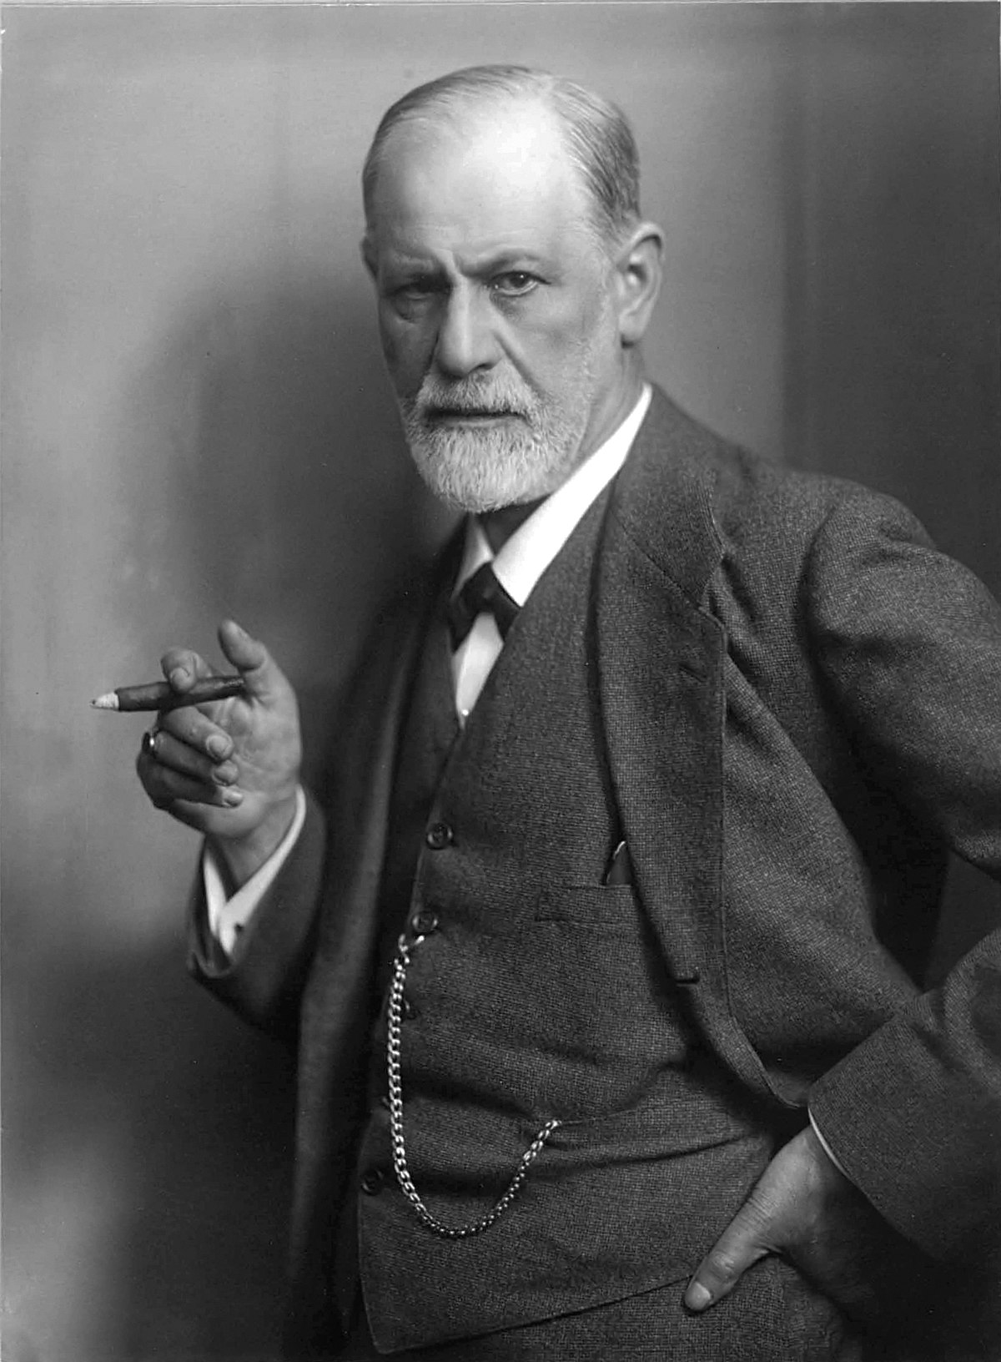
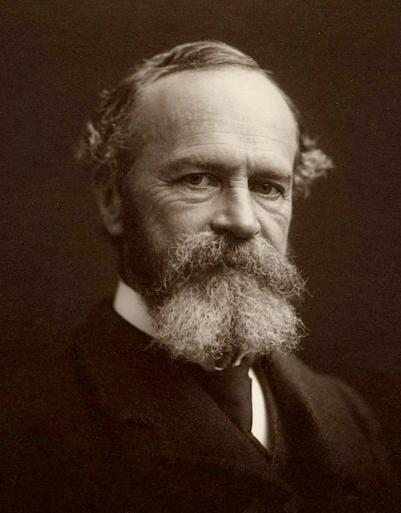
In the beginning...
Introspection Behaviourism
Measuring the mind by looking into one’s consciousness
E.g. Self-reflection
Sigmund Freud’s approach
Measuring the mind by registering behaviours
Stimulus-Response relationships
E.g exams
But how to quantify the mind itself remaind a mystery
Notes:
When psychology first began it was believed that it should be the study of conscious experience. *Talk about introspection*
The early psychologists such as William James (1890) appreciated the intimate relationship between attention, perception and memory, and produced some of the best subjective descriptions of the contents and operations of the mind. Even before James, other researchers attempted to measure the units of sensation that they believed made up the primitive units of experience. For many years the study of the contents of mind were abandoned as impossible to measure scientifically while the Behaviourist movement concentrated on stimulus–response relationships.

Slide 5
But then...
Computers & information processing
Cognition: the mind as a computer
Input – Processing – Output
Simply put: how we know things
Immanuel Kant
Sensation is organized stimuli
Perception is organized sensation
Conception is organized perception
Science is organized conception

Slide 6
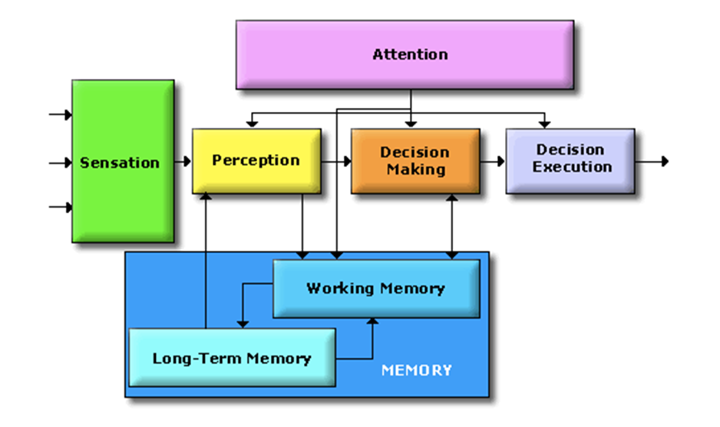
The Cognitive System
Cognitive scientists study intelligence and behavior, with a focus on how the nervous systems represent, processes, transforms, stores and recoveres information.
Essentially, information is captured by sensors
from where it is processed and in different ways:
Like data flowing through an
algorithm!
Key difference is the human minds
limited processing capacity which is
why we need attention! → Selection!
Not actually separate parts; nothing is truely separate, but
classification is how humans deal with information → r.i.p. us
Notes:
On the separate parts:
This approach is taken to aid clarity of explanation, but in so doing, can give the impression that individual aspects of cognition can be understood in isolation from each other. However, it is always important to remember that to properly understand the role of any single aspect of cognition we must appreciate how that role is dependent upon and interacts with other aspects.

Slide 7
Attention
Windows task manager for humans
Attention is how the brain controls its own information processing
Can be measured through conscious introspection, overt and implicit behaviors, electrophysiology and brain imaging
External attention – selection and modulation of sensory information
Selects locations in space, points in time, or modality-specific input
Feature-based or object-based
Integration of objects/features over space, time and modality
Internal attention – selection, modulation and maintenance of internally generated information
High-level cognitive (thoughts, plans, rules & responses, self-monitoring, memories)
Low-level cognitive (bodily functions – pain, hunger, etc.)

Slide 8
Attention
Windows task manager for humans; for our purposes
LIMITED CAPACITY – evolved out of necessity to focus limited processing capacity to the most important information
SELECTION – multiple stimuli compete for selection and the goal is to select the stimulus most relevant to current tasks and goals;
MODULATION – once a stimulus is selected, attention also determines how well it will be processed, how fast and how accurately, and whether it will be later remembered
VIGILANCE – closely related to modulation (which is limited in time and has immediate effects); the ability to sustain attention over extended periods of time

Slide 9
Attentional & Memory
So, what happens why you have attentively watched this lecture?
It was continually selected for perceptual processing; for storing in you short-term memory; declarative knowledge → you can retrieve and express it in language
Memory Type I processing: One of the types of rehearsal in the levels of processing approach, in which information is recirculated at the same level with no additional processing for depth. (repeat set of words)
If you then start applying it in class to design you perceptual model/computer vision information pipeline, then you are really learning; demonstratable knowledge
Memory Type II processing: According the levels of processing approach, this type involves recoding of information to another level of depth and leads to a more durable memory trace. (remember set of words)
However, if you get into a situation which is very attentional demanding you attentionally select other information for processing: Type I processing is overridden.
So that’s something we must avoid!
Smartphones and laptops are designed to be attentionally demanding.
However, perceiving little to no attentionally demanding stimuli helps: walking, looking at nature, meditation, counting sheep etc.

Slide 10

Good news!
I just scientifically proven that in order to learn well you should hand in your phone and close your laptop during and after the lectures!
Please hand them in now!

Slide 11
Today’s Schedule
Before the lecture please hand-in your phone and go for a brief 5 min walk. Afterwards: Free coffee. Tutorial? → Phones back!
Perception
Lecture
Walking-Break: 20 min
Tutorial: Create a flowchart for perceptual processing of sensory information for your robot!
Lunch
Learning
Lecture
Walking-Break: 20 min
Tutorial: Create a flowchart for information; encoded perceptions, processing (a.k.a. learning) for your robot!
Fin!

Slide 12
What will we do this block?
Cognitive science deals with the mental faculties of language, perception, memory, attention, reasoning, and emotion
This block we will go into systems concerning:
Perception: Visual (& kinestaethic)
Memory: Learning
Reasoning: Decision-making
Emotion: Learning & motivation/goals setting
Next block we will go further into:
Language
Attention
Perception: Auditory

Slide 13
Break
Take a walk of 5 minutes and meet me at the Innovation Square!
Be back in 20 minutes for the perception lecture!

Slide 14
Cognition Fundamentals: Perception
How do we learn from our perceptions?
Responsible Lecturer: Bram Heijligers

Slide 15
HCAI Recap
What we already learned...

Slide 16
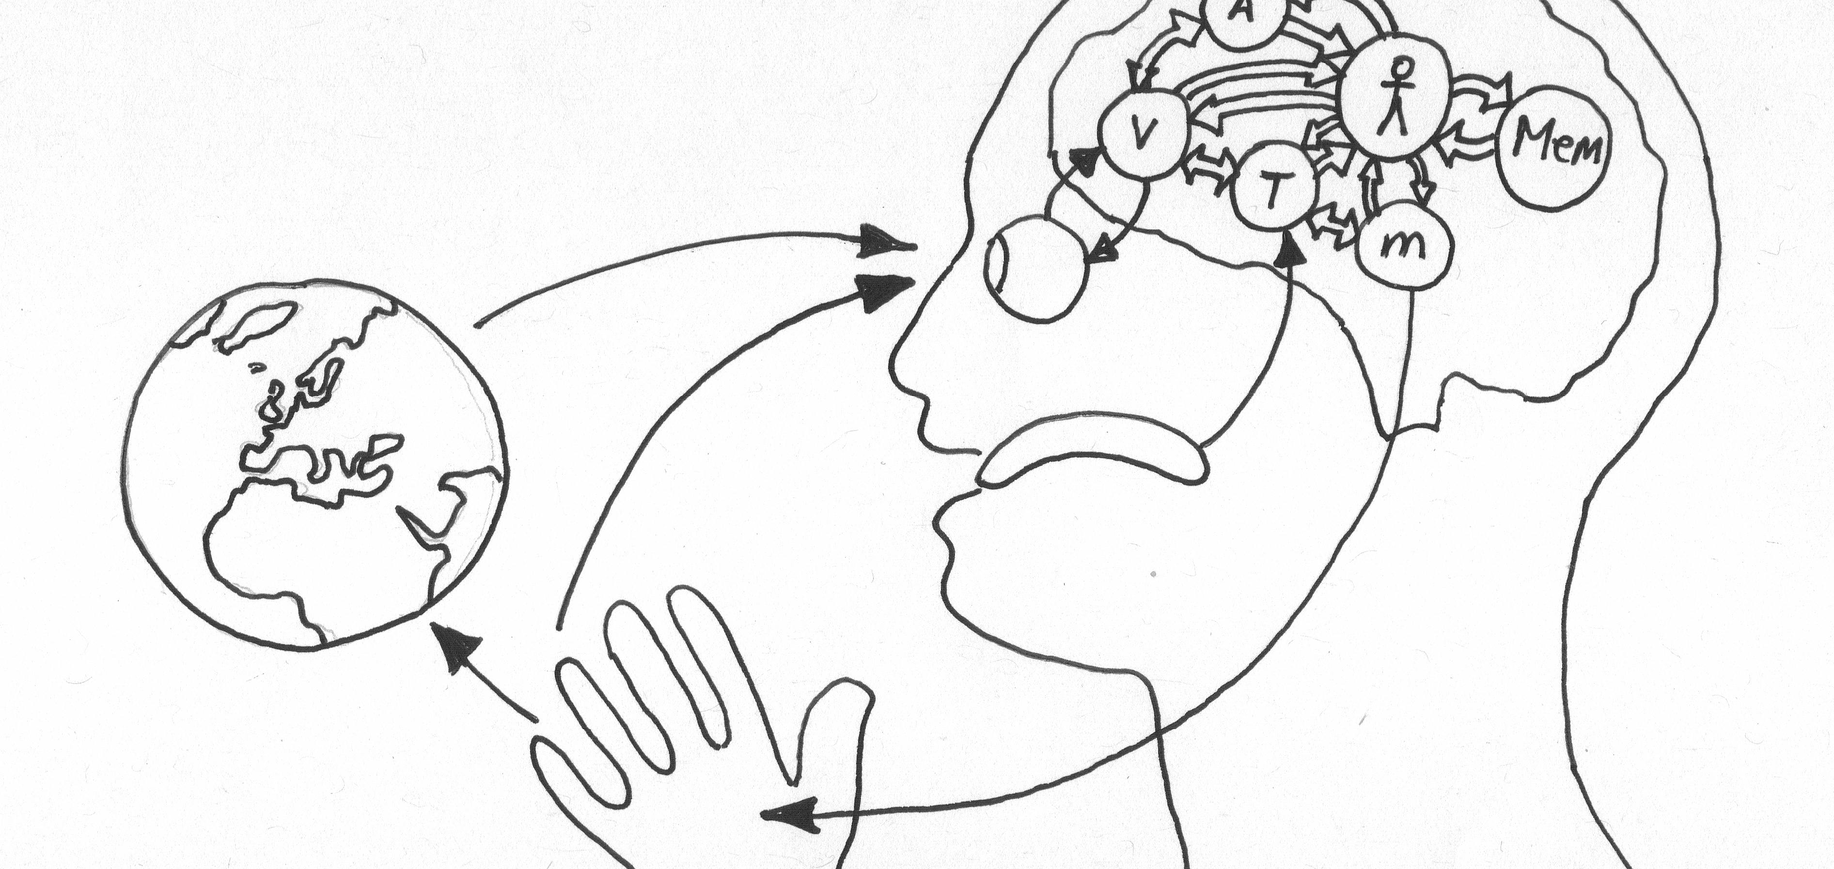
Extended Mind Theory
Objects in the external environment can be part of a cognitive process and in that way function as extensions of the mind itself.
Notes:
What does extended mind theory state? Or what is an extended mind?
[click to add definition]
Can you name some examples of mind extensions?
What is the difference between the mind and the consciousness/brain?
What is the value of Extended Mind Theory for Human Computer interaction?
What are the implications Extended Mind Theory for Human-centered Artificial Intelligence?

Slide 17
Network-Enabled Cognition Theory
The technological and informational elements of a large-scale information network can, under certain circumstances, constitute part of the material supervenience base for(/relationship between) an agent’s mental states and processes.
Notes:
What does Network-Enabled Cognition theory state?
[click to add definition]
Cognitive capacity; working memory is very limited (consicous 100 bits, unconsicious 100k bits) ; AI is only limited by the computation capacity available so it can be a great enrichment to our own intrensic cognitive capacity
Can you name some examples of network-enabled cognition?
What is the difference between the Extended Mind Theory and the network-enabled cognition?
What is the value of Network-Enabled Cognition for Human Computer interaction?
What are the implications of Network-Enabled Cognition for Human-centered Artificial Intelligence?

Slide 18

Interaction
Communication or direct involvement with someone or something: a reciprocal action or influence
Notes:
What is interaction?
[click to add definition]
Why is interaction central to the mind?
Why is interaction fundamental to data exchanges?

Slide 19
Human-Centered Artificial Intelligence
Design discipline within artificial intelligence for designing applications that are reliable, safe, and trustworthy, and effectively serve people's needs.
Notes:
Machine learning (ML) is the science of helping computers discover patterns and relationships in data instead of being manually programmed. Machine or deep learining is a powerful tool for creating personalized and dynamic experiences, and it’s already driving everything from Netflix recommendations to autonomous cars. But as more and more experiences are built with ML, it’s clear that UX designers still have a lot to learn about how to make users feel in control of the technology, and not the other way round.
What is HCAI?
[Click to add definition]
How is HCAI distinct from human-computer interaction?
Essential, products which we perceive as intelligent come with certain assumptions: specifically that the user can anticipate what the product is going to do and that the product anticipates what the user want. In other words, users expect them to respond as quasi-human.

Slide 20
Perception
What is it? How does it related to attention, memory and robotics?

Slide 21
What we learn and why
Learning Objectives
Identify appropriate perceptual features for object detection.
Identify required prior-knowledge for contextualising object detection.
Use cognitive models of pattern recognition to improve feature and/or object detection. → feeds into our object detection algorithm

Slide 22
How do we perceive?
Using our different senses: (Sherrington’s codification)
Teloreceptive (vision and hearing)
Proprioceptive (limb position)
Exteroceptive (touch)
Chemoreceptive (smell and taste)
Interoceptive (visceral, but based on later findings also includes the sense of the physiological condition of the entire body)
may reflect predictions about the expected state of the body rather than actual sensations (Barrett & Simmons, 2015)
For object detection, we’ll now focus on vision!

Slide 23

Visual Perception

Slide 24
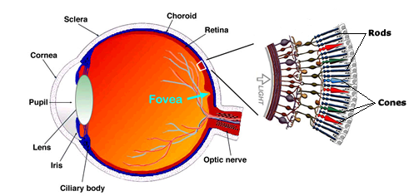
Eye movements
Saccades ~ darting movements of our eyes from one location to another; ca. 3 times/sec.
Followed by short periods of Fixations, moments during which we obtain information about the world (from the fovea)
Is our camera; Field of View moving?

Slide 25
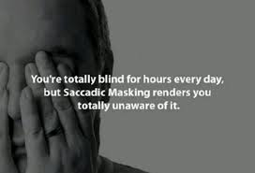
Phenomenal stability
Visual input is disjointed and discontinuous yet we experience no sensation of movement or displacement (“shifting retinal images interleaved with smears of motion”, Higgins & Rayner, 2014)
This is called ‘saccadic suppression’ (masking)
What are the implications for our computer vision algorithm?

Slide 26
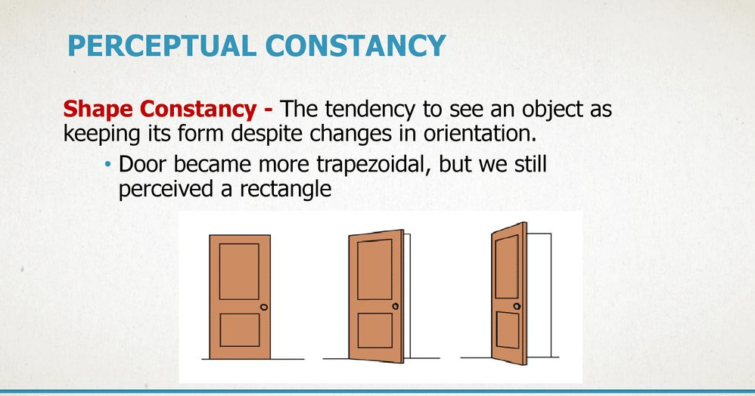
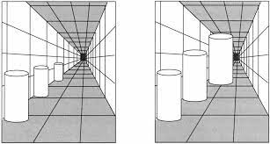
Perceptual constancy: Vision
Space Constancy: the world remains fixed even as the eyes scan across it.
Objects appear at different retinal locations after eye movements but not perceived as displaced
Size Constancy: the tendency to perceive the veridical size of a familiar object despite differences in their distance (and consequent differences in the size of the pattern projected on the retina of the eye)

Slide 27
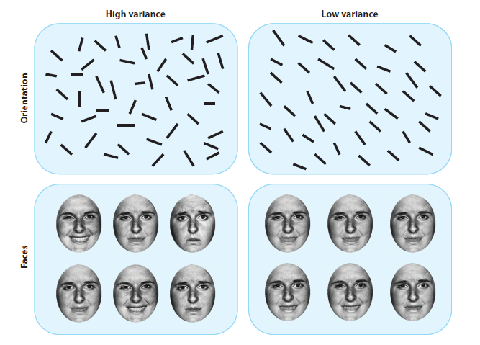
Ensemble perception (Whitney & Leib)
The visual system’s ability to detect and extract information from groups of similar objects (faces, trees, cars,…) that is statistically representative of the whole group, such as motion, orientation, brightness, hue and spatial position
Examples: average hue of tree leaves, average facial expression, average speed of moving cars on the street
Based on ‘holistic’ representations
Brief glances (100 ms or less)
View-point invariant, dynamic
Requires integration of multiple items
Likely operates in other modalities as well

Slide 28
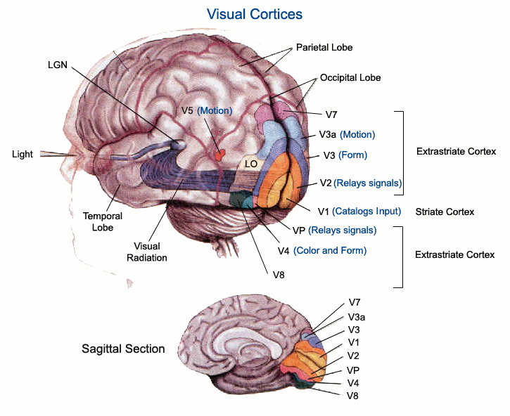
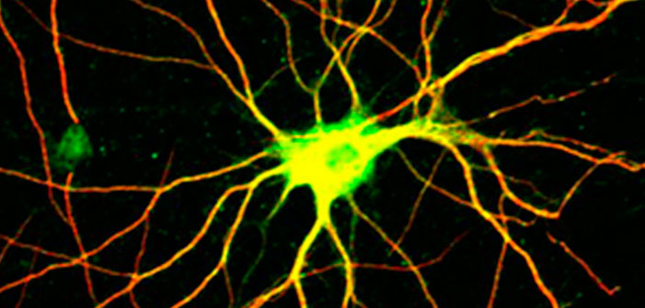
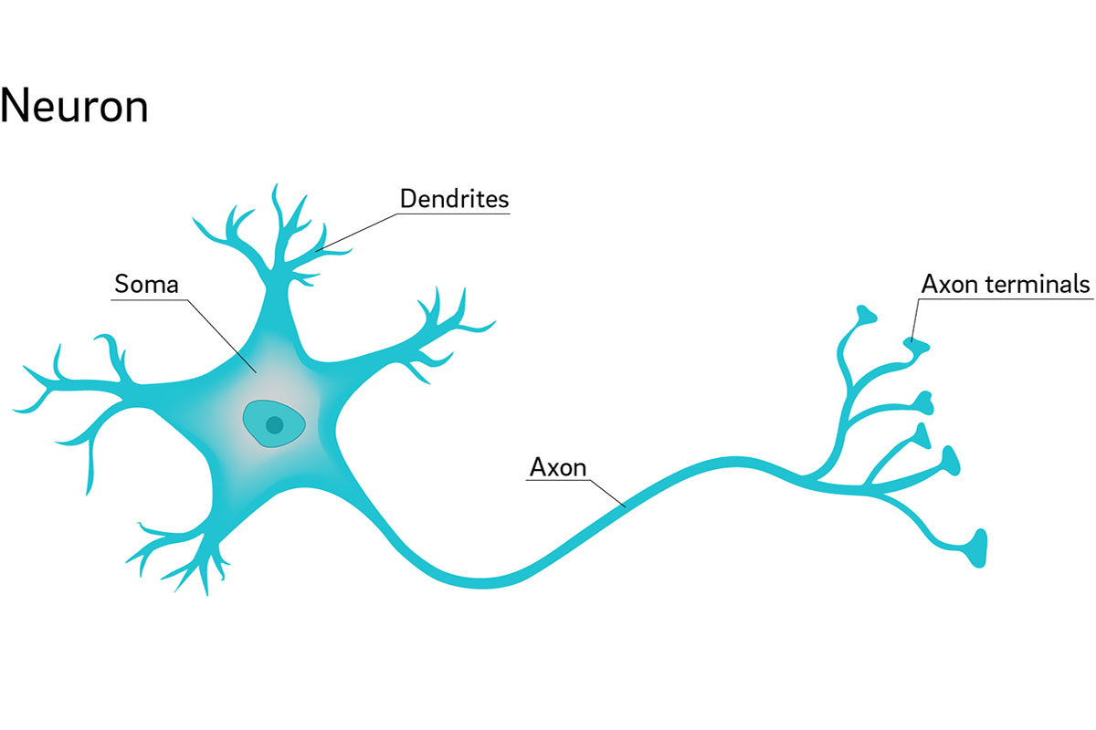
Visual Cortices
Visual perception is created by layered processing of sensory stimuli
Processing clustered in brain area using short-distance neural hubs
And communicated (relays) across the brain using long-distance single connection neurons

Slide 29
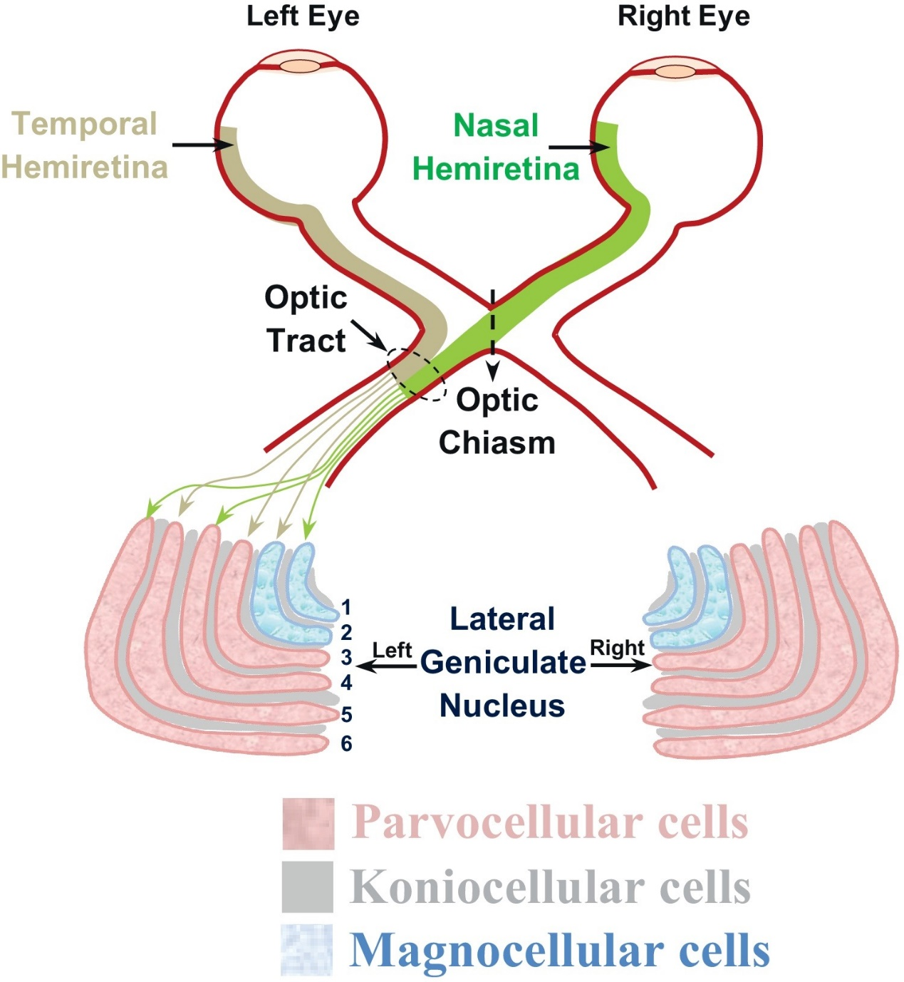
Neural mechanisms of selective visual attention
Neural correlates of top-down attention
Increased firing rates of neurons encoding the attending stimulus (modulation)
Reduced variability of responses to repeated stimuli -> less noise in the signal
Reduced covariability of neuronal responses to repeated stimuli in simultaneously recorded neurons -> reduced redundancy in the signal
In other words: if I focus more on what I see I perceive it better
E.g. Binocular, scanning behaviour

Slide 30
Neural mechanisms of selective visual attention
Neural correlates of bottom-up attention
Pop-out stimuli draw attention automatically
Increased firing rates of neurons generating attentional salience to unattended stimulus
In other words: if something is very stimulating my attention is drawn to it
E.g. Light, fast moving object, reproductive organs

Slide 31
Visual Attention
Sampling & Prioritizing what we perceive
Cannot take in all visual information at once.
Therefore, shift attention around environment to focus on important sources of information.
‘Spotlight’ metaphor
Attention is like a spotlight which moves about and allows us to selectively attend to parts of the visual world.
Michael Posner (1980) suggested that enhanced processing/detection occurs within this ‘spotlight’.
So attention is directed towards ‘space’ according to the spotlight model. It is a space-based model of attention.
How do computers differ?
How do we decide what are appropriate perceptual features for object detection?

Slide 32
Break
Take a walk of 5 minutes and meet me at the Innovation Square!
Be back in 20 minutes for the tutorial!

